Slide 1
Snowflock: Cloud computing made agile
H. Andrés Lagar-Cavilla
Joe Whitney, Adin Scannell, Steve Rumble,
Philip Patchin, Charlotte Lin,
Eyal de Lara, Mike Brudno, M. Satyanarayanan*
University of Toronto, *CMU
andreslc@cs.toronto.edu
http://www.cs.toronto.edu/~andreslc

Slide 2
SnowFlock In One Slide
(The rest of the presentation is one big appendix)
Virtual Machine cloning
Same semantics as UNIX fork()
  All clones are identical, save for ID
  Local modifications are not shared
API allows apps to direct parallelism
Sub-second parallel cloning time (32 VMs)
Negligible runtime overhead
Scalable: experiments with 128 processors

Slide 3
SnowFlock Enables:
Impromptu Clusters: on-the-fly parallelism
  Pop up VMs when going parallel
  Fork-like: VMs are stateful
  Near-Interactive Parallel Internet services
    Parallel tasks as a service (bioinf, rendering…)
    Do a 1-hour query in 30 seconds
  Cluster management upside down
  Pop up VMs in a cluster “instantaneously”
  No idle VMs, no consolidation, no live migration
Fork out VMs to run un-trusted code
  i.e. in a tool-chain
etc…

Slide 4

Embarrassing Parallelism
GATTACA
GACATTA
CATTAGA
AGATTCA
Sequence to align: GACGATA
GATTACA
GACATTA
CATTAGA
AGATTCA
Another sequence to align: CATAGTA

Slide 5
Near-Interactive Internet Services
Embarrassing Parallelism
  Throw machines at it: completion time shrinks
Big Institutions
  Many machines
Near-interactive parallel Internet service
  Do the task in seconds
  NCBI BLAST
  EBI ClustalW2

Slide 6
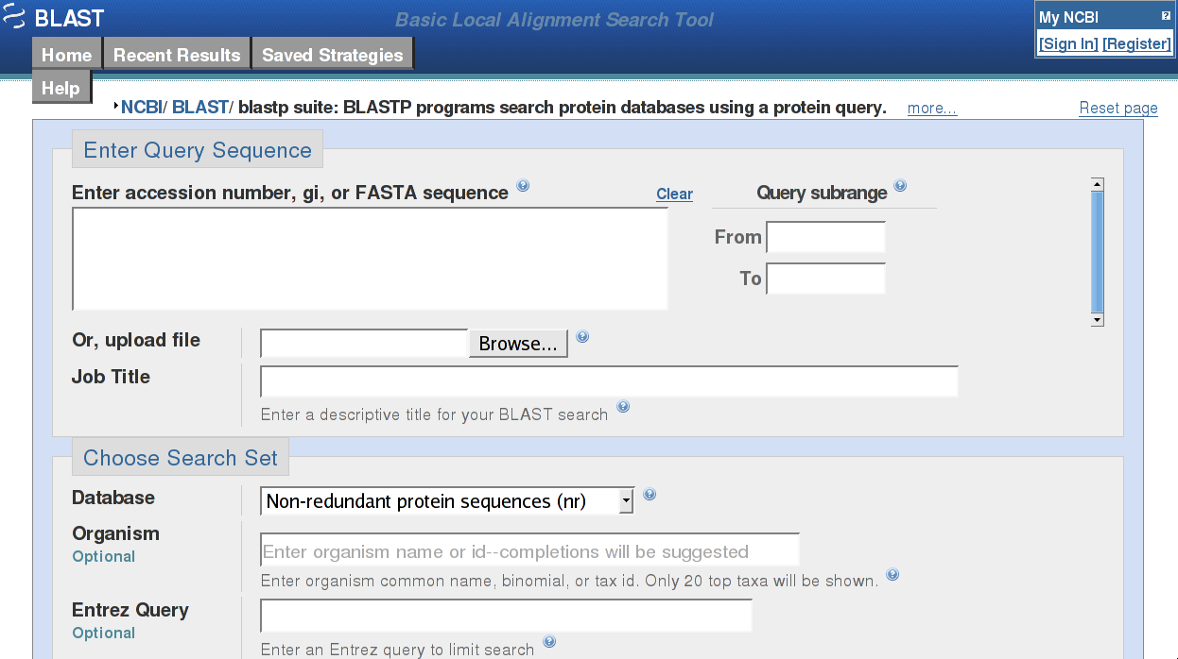
Near-Interactive Internet Services
Notes:
National Centre for Biotechnology Information

Slide 7
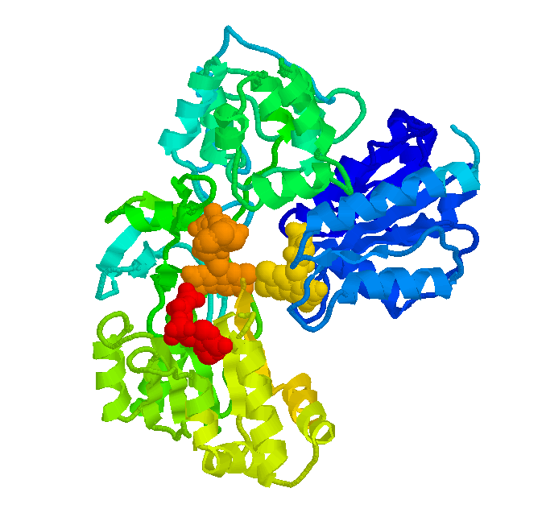



Near-Interactive Internet Services
Embarrassing Parallelism
  Throw machines at it: completion time shrinks
Big Institutions
  Many machines
Near-interactive parallel Internet service
  Do the task in seconds
  NCBI BLAST
  EBI ClustalW2
Not just bioinformatics
  Render farm
  Quantitative finance farm
  Compile farm (SourceForge)

Slide 8
Cloud Computing
Dedicated clusters are expensive
Movement toward using shared clusters
  Institution-wide, group-wide cluster
  Utility Computing: Amazon EC2
Virtualization is a/the key enabler
  Isolation, security
  Ease of accounting
  Happy sys admins
  Happy users, no config/library clashes
    I can be root! (tears of joy)

Slide 9
Parallel Internet Service + VM Cloud
Impromptu: highly dynamic workload
  Requests arrive at random times
  Machines become available at random times
Need to swiftly span new machines
  The goal is parallel speedup
  The target is tens of seconds
VM clouds: slow “swap in”
  Resume from disk
  Live migrate from consolidated host
  Boot from scratch (EC2: “minutes”)
Notes:
Don’t fiddle with seconds/minutes

Slide 10
Impromptu Clusters
Fork copies of a VM
In a second, or less
With negligible runtime overhead
Providing on-the-fly parallelism, for this task
Nuke the Impromptu Cluster when done
Beat cloud slow swap in
  Near-interactive services need to finish in seconds
  Let alone get their VMs

Slide 11

Parallel VM Forking
Impromptu Cluster:
On-the-fly parallelism
0:“Master” VM
Virtual Network
Transient
1:GACCATA
2:TAGACCA
3:CATTAGA
4:ACAGGTA
5:GATTACA
6:GACATTA
7:TAGATGA
8:AGACATA

Slide 12
But How Do I Use This?
SnowFlock API
Programmatically direct parallelism
sf_request_ticket
  Talk to physical cluster resource manager (policy, quotas…)
  Modular: Platform EGO bindings implemented…
Hierarchical cloning
  VMs span physical machines
  Processes span cores in a machine
  Optional in ticket request

Slide 13
But How Do I Use This?
sf_clone
  Parallel cloning
  Identical VMs save for ID
  No shared memory, modifications remain local
  Explicit communication over isolated network
sf_sync (slave) + sf_join (master)
  Synchronization: like a barrier
  Deallocation: slaves destroyed after join

Slide 14
The Typical Script
tix = sf_request_ticket(howmany)
prepare_computation(tix.granted)
me = sf_clone(tix)
do_work(me)
if (me != 0)
send_results_to_master()
sf_sync()
else
collate_results()
sf_join(tix)
Split input query n-ways, etc
Block…
scp … up to you
IC is gone
Notes:
Drive analogies with fork()

Slide 15
Nuts and Bolts
VM descriptors
  VM suspend/resume correct, but slooow
  Distill to minimum necessary
Memtap: memory on demand
  Copy-on-access
Avoidance Heuristics
  Don’t fetch something I’ll immediately overwrite
Multicast distribution
  Do 32 for the price of one
  Implicit prefetch

Slide 16
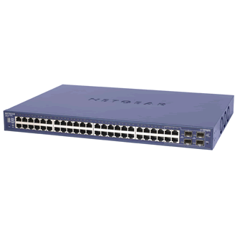
The Secret Sauce
Memory
State
Memtap
?
Virtual
Machine
Multicast
VM Descriptor
VM Descriptor
VM Descriptor
  Metadata
  Pages shared with Xen
  Page tables
  GDT, vcpu
  ~1MB for 1GB VM
Memtap
?

Slide 17
Cloning Time
Order of 100’s of miliseconds: fast cloning
Roughly constant: scalable cloning
  Natural variance of waiting for 32 operations
  Multicast distribution of descriptor also variant

Slide 18
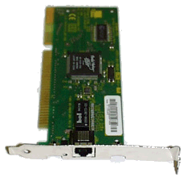
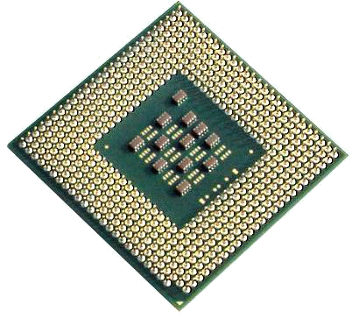
Memtap: Memory-on-demand
Dom0 - memtap
VM
paused
Maps
Page Table
9g056
9g056
R/W
Bitmap
c0ab6
bg756
bg756
Kick back
776a5
0
03ba4
1
1
1
1
00000
00000
9g056
Read-only
Shadow
Page
Table
c0ab6
00000
Kick
00000
Hypervisor
00000
Page Fault
03ba4

Slide 19
Avoidance Heuristics
Don’t fetch if overwrite is imminent
  Guest kernel makes pages “present” in bitmap
Read from disk -> block I/O buffer pages
Pages returned by kernel page allocator
  malloc()
  New state by applications
Effect similar to balloon before suspend
But better
  Non-intrusive
  No OOM killer: try ballooning down to 20-40 MBs

Slide 20
Implementation Topics
Multicast
  Sender/receiver logic
  Domain-specific challenges:
    Batching multiple page updates
    Push mode
    Lockstep
API implementation
  Client library posts requests to XenStore
  Dom0 daemons orchestrate actions
SMP-safety
Virtual disk
  Same ideas as memory
Virtual network
  Isolate Impromptu Clusters from one another
  Yet allow access to select external resources

Slide 21
Implementation Recap
Fast cloning
  VM descriptors
  Memory-on-demand
Little runtime overhead
  Avoidance Heuristics
  Multicast (implicit prefetching)
Scalability
  Avoidance Heuristics (less state transfer)
  Multicast
Notes:
Try too not mention stats

Slide 22
Show Me The Money
Cluster of 32 Dell PowerEdge, 4 cores
  128 total processors
Xen 3.0.3 1GB VMs, 32 bits, linux pv 2.6.16.29
  Obvious future work
Macro benchmarks
  Bioinformatics: BLAST, SHRiMP, ClustalW
  Quantitative Finance: QuantLib
  Rendering: Aqsis (RenderMan implementation)
  Parallel compilation: distcc

Slide 23
Raw Application Performance
143min
67
66
87min
53
110min
56
61min
84
80
7min
55
51
10
9
20min
49
47
128 processors
  (32 VMs x 4 cores)
1-4 second overhead
ClustalW: tighter integration,
best results
Notes:
Click and near interactive appears

Slide 24
Throwing Everything At It
Four concurrent Impromptu Clusters
  BLAST , SHRiMP , QuantLib , Aqsis
Cycling five times
  Ticket, clone, do task, join
Shorter tasks
  Range of 25-40 seconds: near-interactive service
Evil allocation

Slide 25
Throwing Everything At It
Higher variances (not shown): up to 3 seconds
  Need more work on daemons and multicast

Slide 26
Plenty of Future Work
>32 machine testbed
Change an existing API to use SnowFlock
  MPI in progress: backwards binary compatibility
Big Data Internet Services
  Genomics, proteomics, search, you name it
  Another API: Map/Reduce
  Parallel FS (Lustre, Hadoop) opaqueness+modularity
  VM allocation cognizant of data layout/availability
Cluster consolidation and management
  No idle VMs, VMs come up immediately
Shared Memory (for specific tasks)
  e.g. Each worker puts results in shared array

Slide 27
Wrap Up
SnowFlock clones VMs
  Fast: 32 VMs in less than one second
  Scalable: 128 processor job, 1-4 second overhead
Addresses cloud computing + parallelism
Abstraction that opens many possibilities
Impromptu parallelism → Impromptu Clusters
  Near-interactive parallel Internet services
Lots of action going on with SnowFlock

Slide 28
Thanks For Your Time
andreslc@cs.toronto.edu
http://www.cs.toronto.edu/~andreslc

