Slide 1
Snowflock: Cloud computing made agile
H. Andrés Lagar-Cavilla
Joe Whitney, Adin Scannell, Steve Rumble,
Philip Patchin, Charlotte Lin,
Eyal de Lara, Mike Brudno, M. Satyanarayanan*
University of Toronto, *CMU
http://compbio.cs.toronto.edu/snowflock
andreslc@cs.toronto.edu
http://www.cs.toronto.edu/~andreslc

Slide 2
SnowFlock In One Slide
(The rest of the presentation is one big appendix)
Virtual Machine cloning
Same semantics as UNIX fork()
  All clones are identical, save for ID
  Local modifications are not shared
API allows apps to direct parallelism
Sub-second cloning time
Negligible runtime overhead
Scalable: experiments with 128 processors

Slide 3
SnowFlock Enables:
Impromptu Clusters: on-the-fly parallelism
  Pop up VMs when going parallel
  Fork-like: VMs are stateful
  Near-Interactive Parallel Internet services
    Parallel tasks as a service (bioinf, rendering…)
    Do a 1-hour query in 30 seconds
  Cluster management upside down
  Pop up VMs in a cluster “instantaneously”
  No idle VMs, no consolidation, no live migration
Fork out VMs to run un-trusted code
  i.e. in a tool-chain
etc…

Slide 4

Embarrassing Parallelism
GATTACA
GACATTA
CATTAGA
AGATTCA
Sequence to align: GACGATA
GATTACA
GACATTA
CATTAGA
AGATTCA
Another sequence to align: CATAGTA

Slide 5
Near-Interactive Internet Services
Embarrassing Parallelism
  Throw machines at it: completion time shrinks
Big Institutions
  Many machines
Near-interactive parallel Internet service
  Do the task in seconds
  NCBI BLAST
  EBI ClustalW2

Slide 6
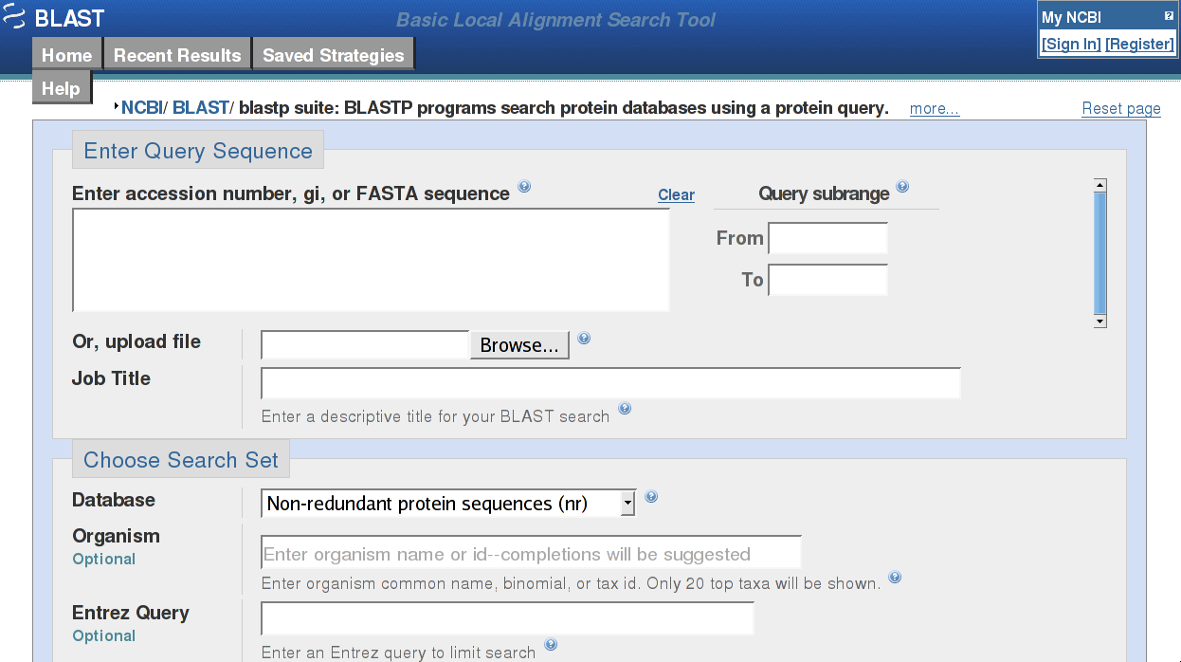
Near-Interactive Internet Services
Notes:
National Centre for Biotechnology Information

Slide 7
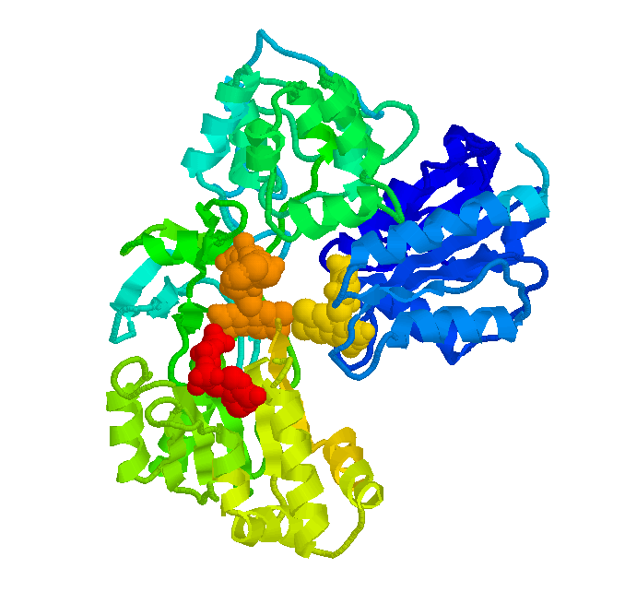



Near-Interactive Internet Services
Embarrassing Parallelism
  Throw machines at it: completion time shrinks
Big Institutions
  Many machines
Near-interactive parallel Internet service
  Do the task in seconds
  NCBI BLAST
  EBI ClustalW2
Not just bioinformatics
  Render farm
  Quantitative finance farm
  Compile Farm (SourceForge)

Slide 8
Cloud Computing
Dedicated clusters are expensive
Movement toward using shared clusters
  Institution-wide, group-wide cluster
  Utility Computing: Amazon EC2
Virtualization is a/the key enabler
  Isolation, security
  Ease of accounting
  Happy sys admins
  Happy users, no config/library clashes
    I can be root! (tears of joy)

Slide 9
Parallel Internet Service + VM Cloud
Impromptu: highly dynamic workload
  Requests arrive at random times
  Machines become available at random times
Need to swiftly span new machines
  The goal is parallel speedup
  The target is tens of seconds
VM clouds: slow “swap in”
  Resume from disk
  Live migrate from consolidated host
  Boot from scratch (EC2: “minutes”)
Notes:
Don’t fiddle with seconds/minutes

Slide 10
Impromptu Clusters
Fork copies of a VM
In a second, or less
With negligible runtime overhead
Providing on-the-fly parallelism, for this task
Nuke the Impromptu Cluster when done
Beat cloud slow swap in
  Near-interactive services need to finish in seconds
  Let alone get their VMs

Slide 11

Parallel VM Forking
Impromptu Cluster:
On-the-fly parallelism
0:“Master” VM
Virtual Network
Transient
1:GACCATA
2:TAGACCA
3:CATTAGA
4:ACAGGTA
5:GATTACA
6:GACATTA
7:TAGATGA
8:AGACATA

Slide 12
But How Do I Use This?
Impromptu Cluster API
Programmatically direct parallelism
sf_request_ticket
  Talk to physical cluster resource manager (policy, quotas…)
  Modular: Platform EGO bindings implemented…
Hierarchical cloning
  VMs span physical machines
  Processes span cores in a machine
  Optional in ticket request

Slide 13
But How Do I Use This?
sf_clone
  Parallel cloning
  Identical VMs save for ID
  No shared memory, modifications remain local
  Explicit communication over isolated network
sf_sync (slave) + sf_join (master)
  Synchronization: like a barrier
  Deallocation: slaves destroyed after join

Slide 14
The Typical Script
tix = sf_request_ticket(howmany)
prepare_computation(tix.granted)
me = sf_clone(tix)
do_work(me)
if (me != 0)
send_results_to_master()
sf_sync()
else
collate_results()
sf_join(tix)
Split input query n-ways, etc
Block…
scp … up to you
IC is gone
Notes:
Drive analogies with fork()

Slide 15
Nuts and Bolts
VM descriptors
  VM suspend/resume correct, but slooow
  Distill to minimum necessary
Memtap: memory on demand
  Copy-on-access
Avoidance Heuristics
  Don’t fetch something I’ll immediately overwrite
Multicast distribution
  Do 32 for the price of one
  Implicit prefetch

Slide 16
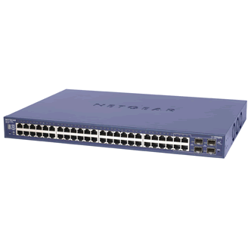
The Secret Sauce
Memory
State
Memtap
?
Virtual
Machine
Multicast
VM Descriptor
VM Descriptor
VM Descriptor
  Metadata
  Pages shared with Xen
  Page tables
  GDT, vcpu
  ~1MB for 1GB VM
Memtap
?

Slide 17
Zooming In: Cloning Time
Clone set up
Multicast descriptor
Xend
resume
code
Wait for clones to start
VM spawn
(from descriptor)
Contact all hosts
Xend suspend code
VM suspend
(make descriptor)

Slide 18
Cloning Time
Order of 100’s of milliseconds: fast cloning
Roughly constant: scalable cloning
  Natural variance of waiting for 32 operations
  Multicast distribution of descriptor also variant

Slide 19
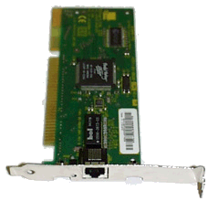
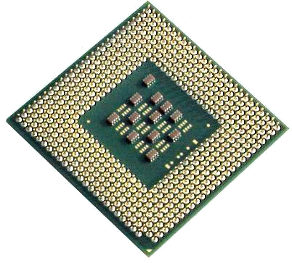
Memtap: Memory-on-demand
Dom0 - memtap
VM
paused
Maps
Page Table
9g056
9g056
R/W
Bitmap
c0ab6
bg756
bg756
Kick back
776a5
0
03ba4
1
1
1
1
00000
00000
9g056
Read-only
Shadow
Page
Table
c0ab6
00000
Kick
00000
Hypervisor
00000
Page Fault
03ba4

Slide 20
Memory on Demand Latency
Network
(unicast)
Memtap logic
(map page)
Context switch
to dom0
Xen hypervisor
(shadow PT)
SnowFlock
in hypervisor
Page Fault (HW)

Slide 21
Avoidance Heuristics
Don’t fetch if overwrite is imminent
  Guest kernel makes pages “present” in bitmap
Read from disk -> block I/O buffer pages
Pages returned by kernel page allocator
  malloc()
  New state by applications
Effect similar to balloon before suspend
But better
  Non-intrusive
  No OOM killer: try ballooning down to 20-40 MBs

Slide 22
Effect of Heuristics and Multicast
SHRiMP 32 clones, 1GB Memory footprint
Heuristics
OFF
Heuristics
ON
10K
18K
10K
Push saves many client requests
Lockstep: Single reply for many requests
Sent only 40 Megs!
But push sends more data
Notes:
Units are confusing, megs, ks thousands

Slide 23
API Implementation
Client library in VM (C, Python, Shell)
Marshall and post requests to Xenstore
  Shared memory control interface
SnowFlock daemon in dom0
  Watches Xenstore and posts replies
Daemons make up a distributed system
  Orchestrate cloning, joining
  Suspend VM to produce descriptor
  Distribute descriptor
  Use descriptor to spawn clones

Slide 24
Implementation Topics
Multicast
  Sender simple: rate limiting, switch programming
  Receiver in charge of reliability: time-out, resend
  Push mode to exploit spatial locality
  Lockstep awareness
  Batching multiple page updates
SMP-safety
Virtual disk
  Same ideas as memory
Virtual network
  Isolate ICs from one another
  Yet allow access to select external resources

Slide 25
Implementation Recap
Fast cloning
  VM descriptors
  Memory-on-demand
Little runtime overhead
  Avoidance Heuristics
  Multicast (implicit prefetching)
Scalability
  Avoidance Heuristics (less state transfer)
  Multicast
Notes:
Try too not mention stats

Slide 26
Show Me The Money
Cluster of 32 Dell PowerEdge, 4 cores
  128 total processors
Xen 3.0.3 1GB VMs, 32 bits, linux pv 2.6.16.29
  Obvious future work
Macro benchmarks
  Bioinformatics: BLAST, SHRiMP, ClustalW
  Quantitative Finance: QuantLib
  Rendering: Aqsis (RenderMan implementation)
  Parallel compilation: distcc

Slide 27
Application Run Times
128 processors
  (32 VMs x 4 cores)
1-4 second overhead
ClustalW: tighter integration,
best results
Notes:
Ideal is really ideal
Low is good

Slide 28
Application Parallel Speedup
110min
143min
87min
61min
20min
7min
Measured against ideal with one processor
Embarrassing parallelism: hour-long task shrunk to seconds
As fast as slowest worker
Notes:
High is good

Slide 29
Throwing Everything At It
Four concurrent Impromptu Clusters
  BLAST , SHRiMP , QuantLib , Aqsis
Cycling five times
  Ticket, clone, do task, join
Shorter tasks
  Range of 25-40 seconds: near-interactive service
Evil allocation

Slide 30
Throwing Everything At It
Higher variances (not shown): up to 3 seconds
  Need more work on daemons and multicast

Slide 31
Multicast Scalability
BLAST, heuristics on,
but 256MB DB cached in memory
Push too
aggressive
Unicast doesn’t scale
Notes:
Further explain ideal

Slide 32
Plenty of Future Work
>32 machine testbed
Change an existing API to use ICs
  MPI in progress: backwards binary compatibility
  mpirun –np 128 -> forks 128 clones
Cluster consolidation and management
  Much much simpler with VM cloning
  No idle VMs, VMs come up immediately
Shared Memory
  For specific tasks
  In many workloads, all we need is a shared array
  Each worker “files” its results before calling sf_sync
Notes:
Do not use “flux”
Drop shmem

Slide 33
Big Data
Genomics, Proteomics, Search
All exhibit embarrassing parallelism
Big-Data Internet services
VM allocation cognizant of data availability
VM data R/W warms physical node cache
  Indices created by one IC used by other ICs
API porting take 2: Map/Reduce
VM modularly/opaquely uses appropriate FS
  Lustre, Hadoop, PVFS, pNFS
Open Data: go to any cloud, crunch the data

Slide 34
Wrap Up
SnowFlock clones VMs
  Fast: 32 VMs in less than one second
  Scalable: 128 processor job, 1-4 second overhead
Addresses cloud computing + parallelism
Abstraction that opens many possibilities
Impromptu parallelism → Impromptu Clusters
  Near-interactive parallel Internet services
Lots of action going on with SnowFlock

Slide 35
Thanks For Your Time
andreslc@cs.toronto.edu
http://www.cs.toronto.edu/~andreslc
http://compbio.cs.toronto.edu/snowflock

Slide 36
Backup

Slide 37

Meet A Protein
Sequence of Amino acids
  CFGATTGATTACAC
Notes:
NFS slide breaks flow (probably will move to the front)
Tim’s question: get the data
Refer to LaMarca
20 min talk: push, hierarchical, last two results

Slide 38
Near-Interactive Internet Services
Embarrassing Parallelism
Throw machines at a task
Time to completion shrinks
Loose or no synchronization between parallel workers

Slide 39
Straw Man Experiment
Linear … minutes … arggh!!

Slide 40
Impromptu Clusters
Impromptu: highly dynamic workload
Need to swiftly span new machines
  Near-interactive service: tens of seconds
VM clouds have slow “swap in”
  Minutes, tens of seconds
Impromptu Cluster (IC)
  Fork copies of a VM
  In a second, or less
  With negligible runtime overhead
  Providing on-the-fly parallelism, for this task
  Nuke the IC when done

Slide 41
Impromptu Clusters
Bioinformatics Rendering
Quantitative Finance etc…
CLOUD COMPUTING
UNBOUNDED
PARALLELISM
VIRTUALIZATION
NEAR-INTERACTIVE
INTERNET SERVICES
IMPROMPTU CLUSTERS
VIRTUAL MACHINE
PARALLEL FORK

Slide 42
fork()
A bit of a kitchen sink abstraction
  Copy an entire process
But quite a comfortable one
New stateful computing element
Tricks under the hood make it viable
  COW et al.
Same thing for VM cloning

Slide 43
Hierarchical Forking
Clone VMs
  Then fork processes
VMs span physical machines
Processes span cores in a machine
Intuition: better to spawn one 4-vcpu VM then four 1-vcpu VMs
Optional
  One may want to leverage VM cloning only
  Automated process forking may not fit all needs

Slide 44
Anatomy of a VM Descriptor
Metadata (Xend, virtual I/O devices)
Pages shared with Xen
Memory management data structures
  Segmentation: GDT
  Page Tables: bulk of the descriptor
Physical memory addresses canonicalized
  Machine->physical
Loosely constant-sized, small
  1MB for a 1GB VM

Slide 45
Memtap: Memory-on-demand
Dom0 - memtap
VM
(paused)
Maps
Page Table
9g056
9g056
R/W
Bitmap
Heuristics
c0ab6
bg756
bg756
Write-only
776a5
Kick back
0
1
03ba4
1
1
1
1
00000
00000
9g056
Read-only
Shadow
Page
Table
c0ab6
00000
Kick
00000
Hypervisor
00000
Page Fault
03ba4
Notes:
No heuristics here
No more than one thing happening at once

Slide 46
Multicast Distribution
Sender simple
  Switch programming
  Rate-limit
Receiver in charge of reliability
  Time out, request again
Optional push mode
  Exploit spatial locality of memory accesses
  Send x, x+1, x+2….
Lockstep
  Clone VMs start simultaneously, with a slight skew
  And access memory similarly, with a slight skew
  Ignore repeated requests within a small window

Slide 47
Multicast Distribution
Sender simple
IGMP group management
  Tell switch what to do
  Handshake protocol to add new clients
Logic to rate-limit sending
  Must not overflow receivers
  Keep receiver averages, drop rate on message drop
Optional push mode
  Exploit spatial locality of memory accesses
  Send x, x+1, x+2….

Slide 48
Multicast Distribution (2)
Receiver in charge of reliability
  Time out, ask again
  Receiving rate fed back to sender
Lockstep avoidance
  All cloned VMs start from the same instruction
  With a slight skew
  Likely to receive n requests for the same page
    Slightly skewed
  Send once, ignore the rest for a small window of time

Slide 49
Virtual I/O
Virtual disk: same principles as memory
  Multicast distribution
  Don’t fetch if overwrite is imminent
  Lightly exercised, in general
Virtual network: isolation
  Multiple “virtual clusters” coexisting
  Discriminate traffic, avoid address clashes
  Ebtables filtering
  Need to access cluster-hosted data, outside world
    Iptables routing
  Also automatic IP reconfig based on clone ID

Slide 50
Changing ClustalW
tix = ic_request_ticket(howmany)
me = ic_clone(tix)
for i in pairs
for j in pairs
pairwise_align(i,j)
send_results_to_master()
ic_sync()
else
collate_results()
ic_join(tix)

Slide 51
Throwing Everything At It
Four concurrent Impromptu Clusters
  BLAST , SHRiMP , QuantLib , Aqsis
Cycling five times
  Ticket, clone, do task, join
Shorter tasks
  Range of 25-40 seconds: near-interactive service
Evil allocation
  32 processors to each task
  One per physical host
  Each host holds one VM for each IC
  Each hosts receives multicast for each IC
Notes:
Animate

Slide 52
Cloning Time
Order of 100’s of miliseconds
Roughly constant
  Natural variance of waiting for 32 operations
  Multicast distribution of descriptor also variant

Slide 53
Parallel VM Forking
Impromptu Cluster:
On-the-fly parallelism
0:“Master” VM
Virtual Network
Transient
1:GACCATA
2:TAGACCA
3:CATTAGA
4:ACAGGTA
5:GATTACA
6:GACATTA
7:TAGATGA
8:AGACATA

