Slide 1

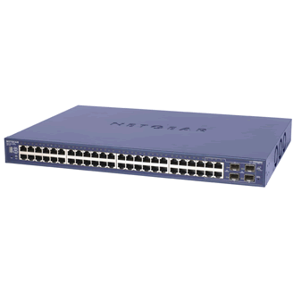
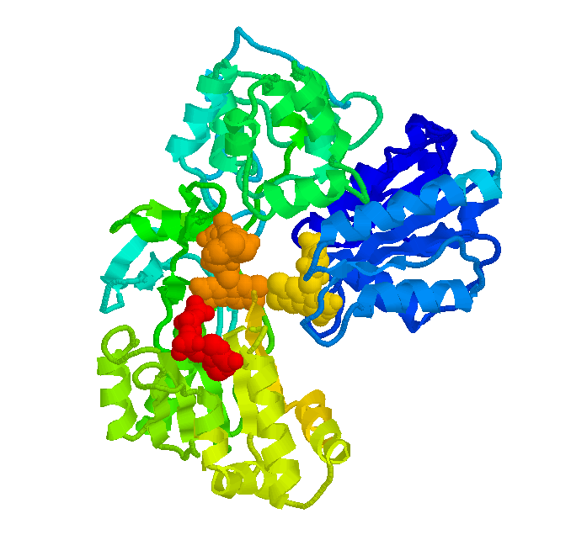





SnowFlock: VM Cloning for Parallel Cloud Computing
H. Andrés Lagar-Cavilla, Joseph Whitney, Adin Scannell, Stephen Rumble, Eyal de Lara, Michael Brudno, M. Satyanarayanan*
University of Toronto, *Carnegie Mellon University
andreslc@cs.toronto.edu
KEY POINTS
Implementation
Virtual Machine cloning
Same semantics as UNIX fork()
  All clones are identical, save for ID
  Local modifications are not shared
API allows applications to direct parallelism
Sub-second cloning time
Negligible runtime overhead
Scalable: experiments with 128 processors
VM descriptors: fast cloning
  Distill VM suspend/resume to minimum necessary
Memtap: memory on demand
  Copy-on-access the rest of the state
Avoidance Heuristics: efficiency
  Don’t fetch pages given to malloc, I/O buffers
Multicast distribution: scalability and prefetching
  Do 32 for the price of one
Originating VM
(1) Make VM descriptor
Near-Interactive Parallel Internet Service
VM descriptor
(2) Descriptor distributed
Applications that exhibit embarrassing parallelism
Offered as a near-interactive service by large institutions
  Hour-long queries solved in seconds
Memory State
(3) Descriptor
spawns VM
Multicast
Bioinformatics NCBI BLAST EBI ClustalW | Render Farms | Quantitative Finance | Compile Farms SourceForge
VM descriptor
VM descriptor
memtap
memtap
Parallel Services In The Cloud
VM Clone 1
(4) State fetched on-demand
VM Clone 2
Fetched page
Impromptu Parallelism → Impromptu Clusters
  Requests arrive at any time
  Machines become available at any time
VM “swap in” in the cloud takes seconds/minutes
  Resume from disk., boot, live migrate
SnowFlock: swiftly span new machines, leverage parallelism
  Provide near-interactive response times (tens of seconds)
Fetch avoided (heuristics)
Some Results
67
65
This API…
56
53
80
84
55
51
tix = sf_request_ticket(howmany)
prepare_computation(tix.granted)
me = sf_clone(tix)
do_work(me)
if (me != 0)
send_results_to_master()
sf_sync()
else
collate_results()
sf_join(tix)
10
9
49
47
… Gives You This: Impromptu Clusters
On-the-fly parallelism
Immediately pop up multiple identical VMs
Talking on their own isolated network
What’s Next?
Physical cluster node
Virtual Machine
Impromptu Cluster
Turn cluster management upside down
  No idle VMs, no consolidation, no live migration
Big Data
  Map/Reduce, Lustre, Hadoop

